Slide 1

Weekly Commodity & Shipping Index

Slide 2
Polysilicon
Index Analysis

Slide 3
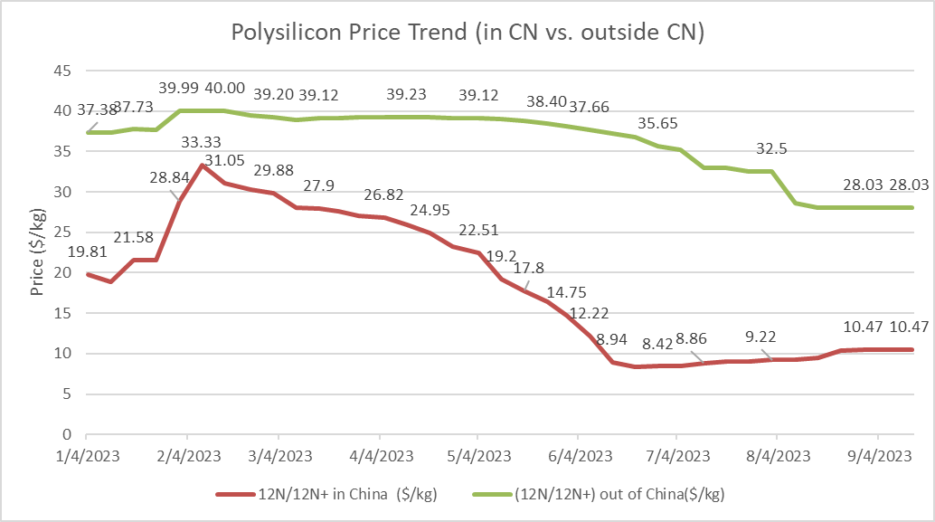
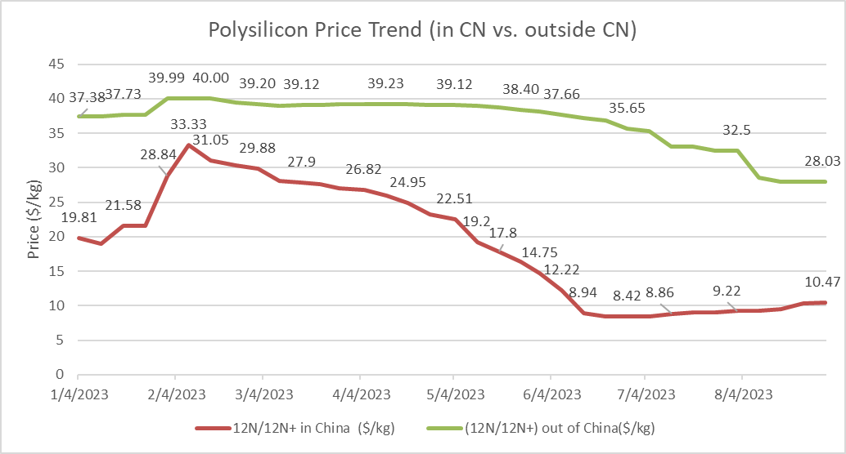
SOP Weekly Project Update – September 15, 2023 – Polysilicon Spot Price (12N/12N+)
Outside CN (12N/12N+)
2W: Aug 30th ($28.03/kg = $0.0701/w) to
Sep 13th ($28.03/kg = $0.0701/w) : No Change
YTD: Jan 2023 Average ($37.55/kg = $0.0938/w) to
Sep 13th ($28.03/kg = $0.0701/w): 25.35% decrease
In CN (12N/12N+)
2W: Aug 30th ($10.47/kg = $0.0262/w) to
Sep 13th ($10.47/kg = $0.0262/w): No Change
YTD: Jan 2023 Average ($20.47/kg = $0.0511/w) to
Sep 13th ($10.47/kg = $0.0262/w): 48.85% decrease
Date | 12N/12N+ in China ($/kg) | (12N/12N+) out of China($/kg)
7/5/2023 | 8.42 | 35.25
7/12/2023 | 8.86 | 33.00
7/19/2023 | 9.06 | 33.00
7/26/2023 | 9.06 | 32.5
8/2/2023 | 9.22 | 32.5
8/9/2023 | 9.24 | 28.56
8/16/2023 | 9.53 | 28.03
8/23/2023 | 10.33 | 28.03
8/30/2023 | 10.47 | 28.03
9/14/2023 | 10.47 | 28.03
$/w calculated per BNEF data: $4/kg polysilicon = $0.01/watt module
Source: http://pvinsights.com/

Slide 4
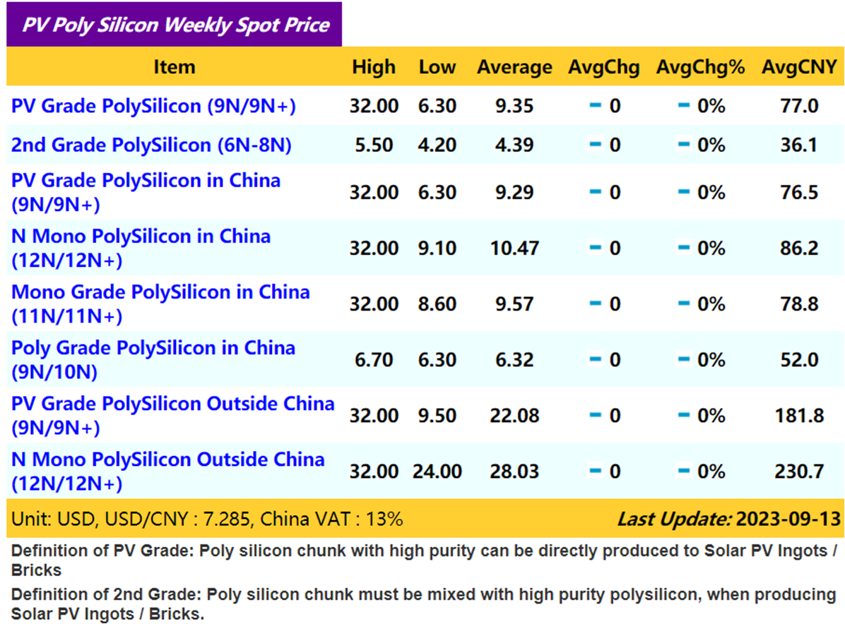
SOP Weekly Project Update – September 15, 2023 – Polysilicon Spot Price
$/w calculated per BNEF data: $4/kg polysilicon = $0.01/watt module
Source: http://pvinsights.com/
1W (12N/12N+):
Outside CN: Jun 28th ($35.65/kg = $0.0891/w) to Jul 5th ($35.25/kg = $0.0881/w) : 1.12% decrease
In CN: Jun 28th ($8.42/kg = $0.0211/w) to Jul 5th ($8.42/kg = $0.0211/w): No Change

Slide 5
Steel
Index Analysis
(Overseas & U.S.)

Slide 6
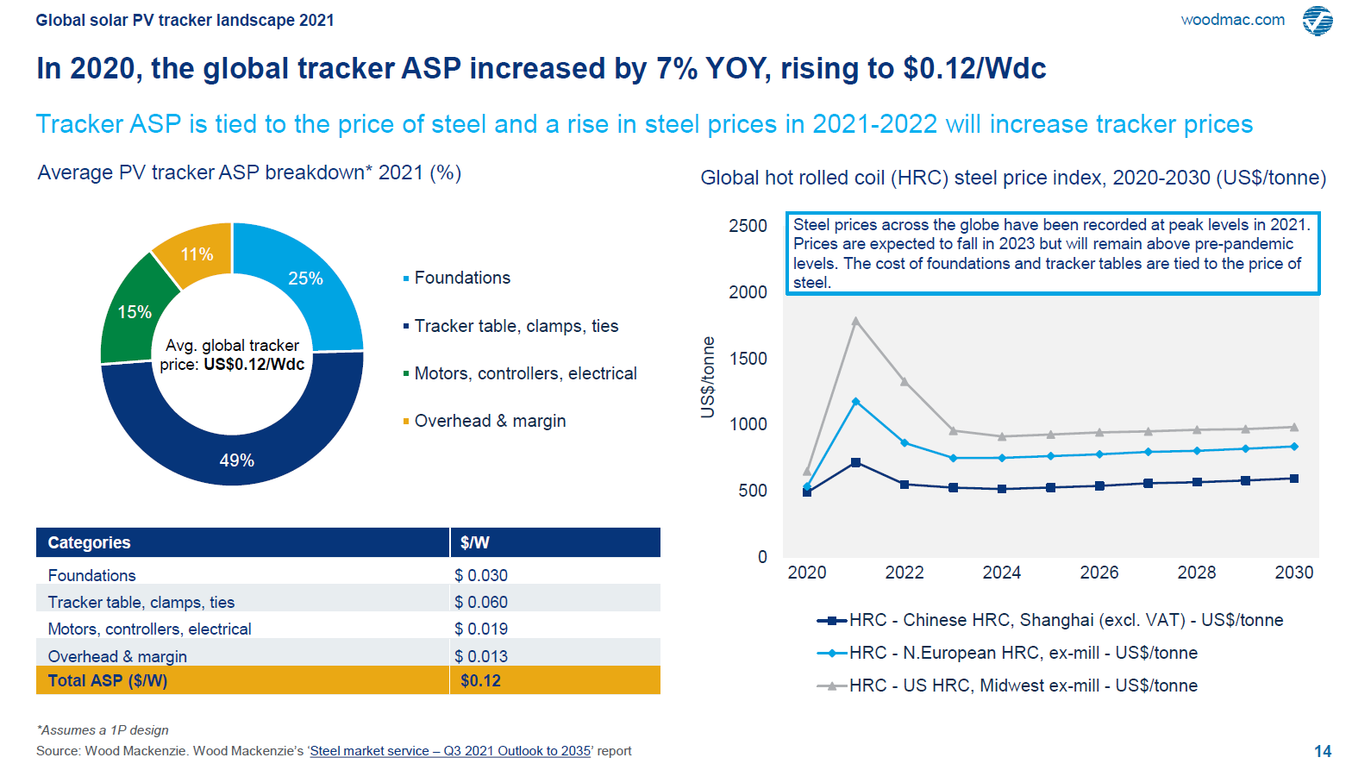
SOP Weekly Project Update – September 15, 2023 – Global Steel and Aluminum Index Analysis

Slide 7


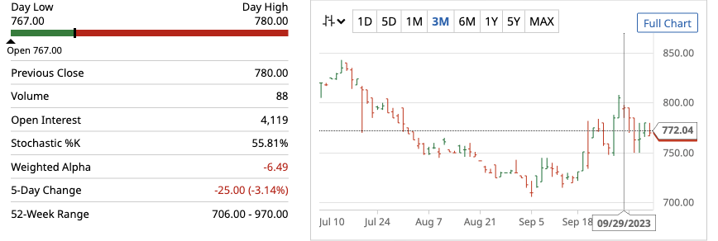
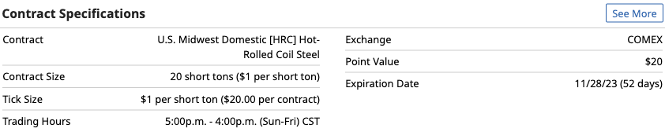
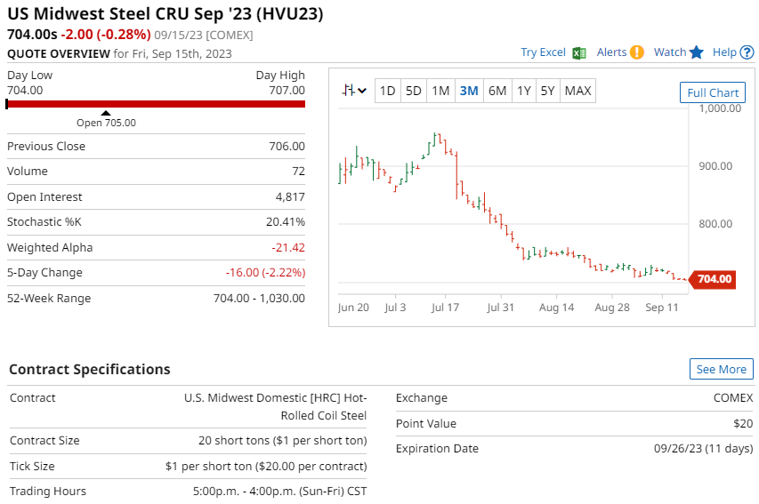

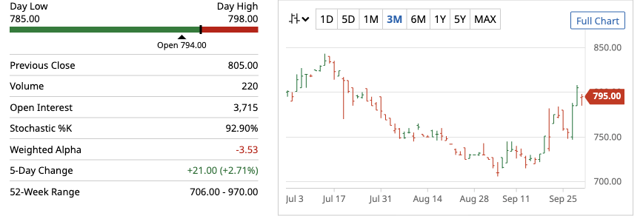

SOP Weekly Project Update – September 15, 2023 – US Steel Index Analysis
9/15 Update: US Midwest Hot-Rolled Coil Steel (HRC)
Source: https://www.barchart.com/futures/quotes/HV*1/overview

Slide 8
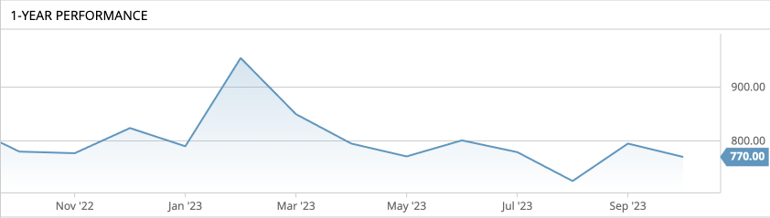
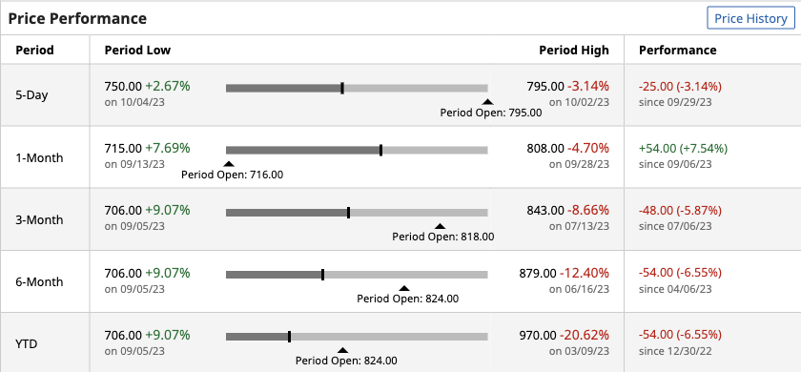
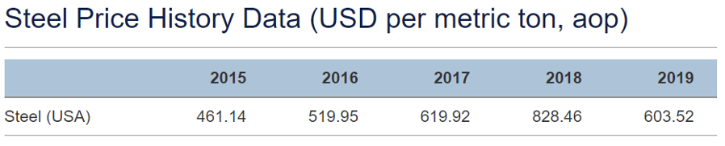

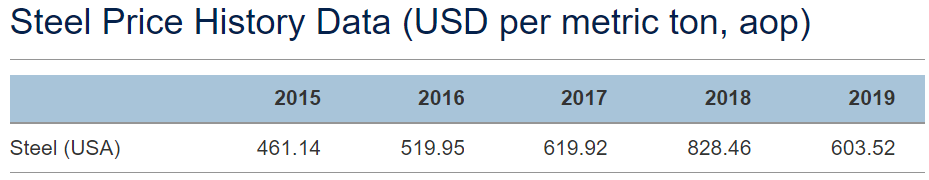
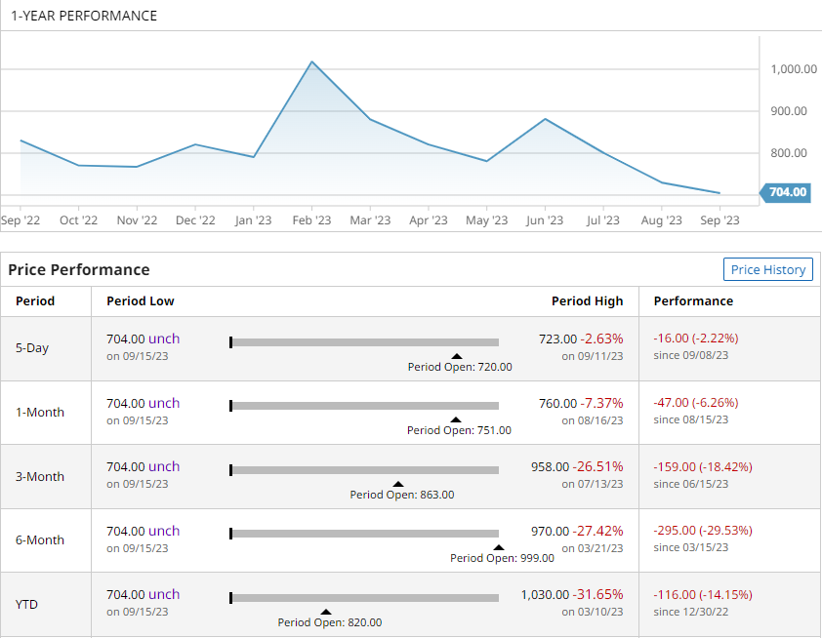
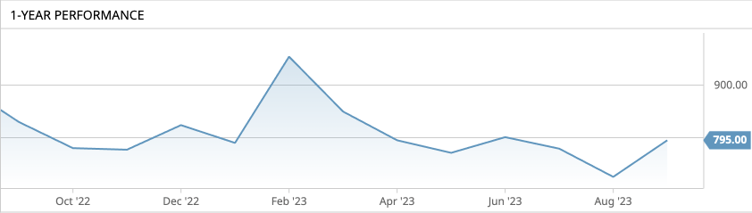
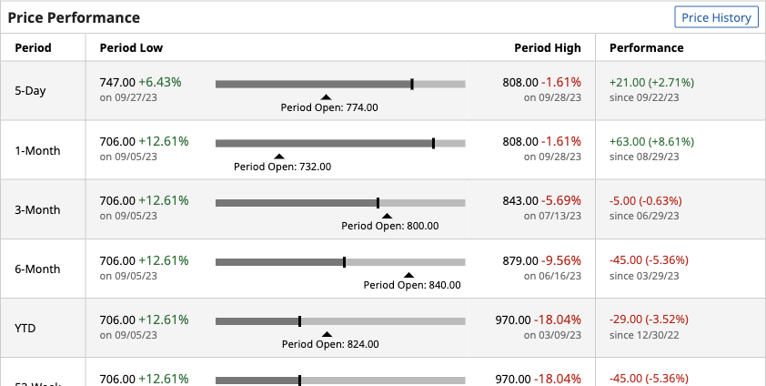
SOP Weekly Project Update – September 15, 2023 – US Steel Index Analysis
9/15 Update: US Midwest Hot-Rolled Coil Steel (HRC)
Steel (U.S)
2W- Sep 1st ($704/T = $84.48/w) to October 07 ($770.00/T = $92.4/w)
9.38% increase
Last meeting: 2.22% decrease
YTD- Jan 1st 2023 ($744/T = $89.28/w) to October 07 ($770.00/T = $92.4/w)
3.49% increase
1Y- Sep 2022 ($830/T = $99.6/w) to October 07 ($770.00/T = $92.4/w)
7.23% decrease
$/w calculated based on global tracker ASP at $0.12/W in 2021, and steel composing 60% of tracker raw materials
Source: https://www.barchart.com/futures/quotes/HV*1/performance

Slide 9
Ocean and In-land Shipping Cost Index Analysis

Slide 10
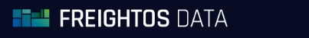
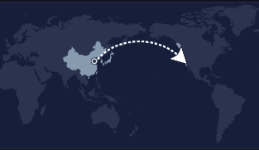

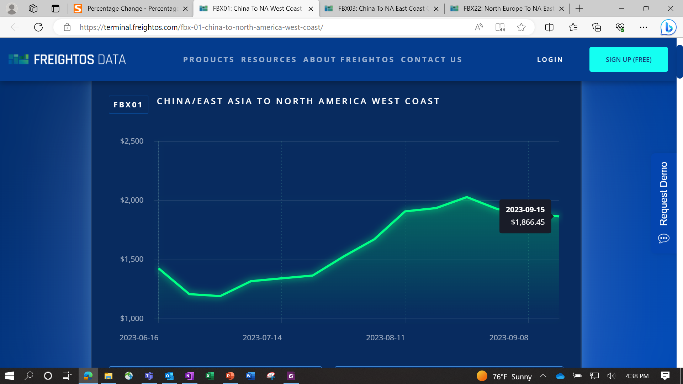
SOP Weekly Project Update – September 15, 2023 – Ocean Shipping Cost Index Analysis
9/15 Update: China/East Asia to NA West Coast
2W – Sep 1st ($1,927/FEU = $0.0077/w) to
Sep 15th ($1,866/FEU = $0.0075/w)
3.17% decrease
Last meeting: 5.03% decrease
YTD- Jan 1st 2023 ($1,382/FEU = $0.0055/w) to
Sep 15th ($1,866/FEU = $0.0075/w)
35.02% increase
1Y – Sep 2022 ($4,314/FEU = $0.0173/w) to
Sep 15th ($1,866/FEU = $0.0075/w)
56.75% decrease
FEU = Forty-foot Equivalent Unit Container
$/w calculated per Container Volume of 0.25MW
Pre-pandemic 2020 rates around $2,800/FEU ($0.011): 33.36% decrease
Source: https://fbx.freightos.com/freight-index/FBX01

Slide 11


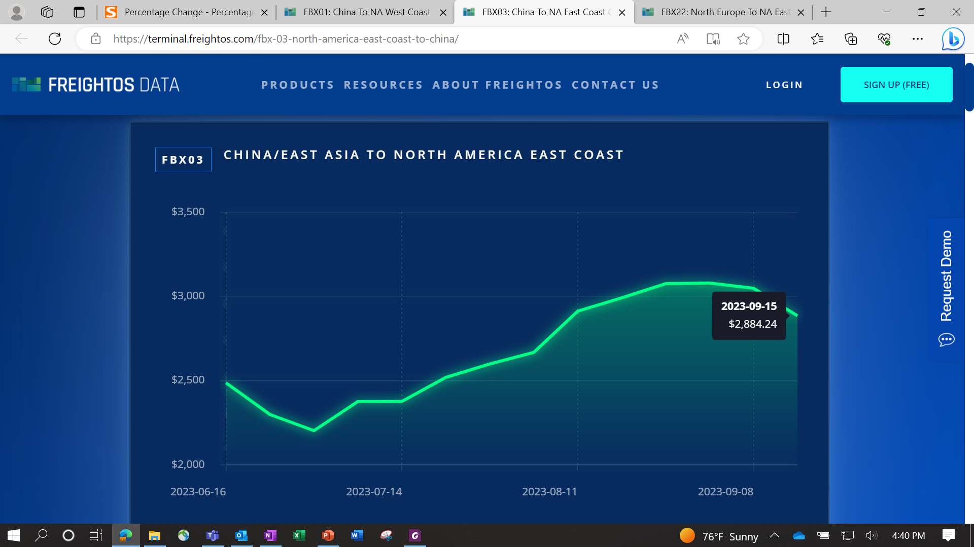
SOP Weekly Project Update – September 15, 2023 – Ocean Shipping Cost Index Analysis
9/15 Update: China/East Asia to NA East Coast
2W – Sep 1st ($3,079/FEU = $0.0123/w) to
Sep 15th ($2,884/FEU = $0.0115/w)
6.33% decrease
Last meeting: 0.13% increase
YTD- Jan 1st 2023 ($2,898/FEU = $0.0115/w) to
Sep 15th ($2,884/FEU = $0.0115/w)
0.48% decrease
1Y – Sep 2022 ($8,704/FEU = $0.0348/w) to
Sep 15th ($2,884/FEU = $0.0115/w)
66.87% decrease
FEU = Forty-foot Equivalent Unit Container
$/w calculated per Container Volume of 0.25MW
Pre-pandemic 2020 rates around $3,500/FEU ($0.014): 17.60% decrease
Source: https://fbx.freightos.com/freight-index/FBX03

Slide 12


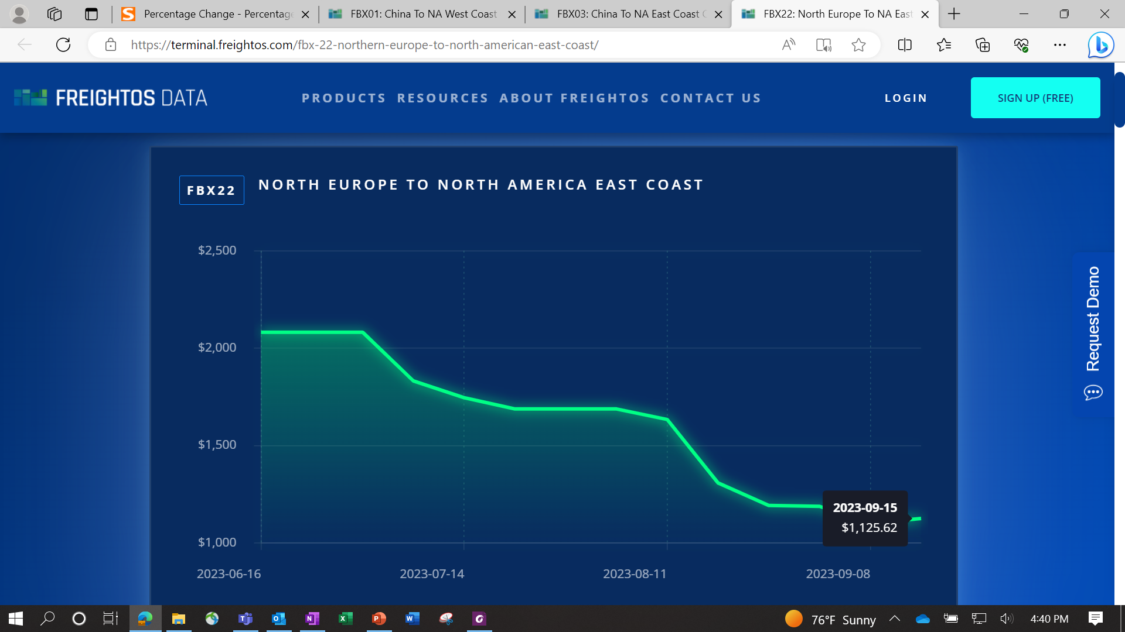
SOP Weekly Project Update – September 15, 2023 – Ocean Shipping Cost Index Analysis
9/15 Update: North Europe to NA East Coast
2W - Sep 1st ($1,188/FEU = $0.00475/w) to
Sep 15th ($1,126/FEU = $0.00450/w)
5.22% decrease
Last meeting: 0.42% decrease
YTD - Jan 1st 2023 ($5,724/FEU = $0.0229/w) to
Sep 15th ($1,126/FEU = $0.00450/w)
80.33% decrease
1Y – Sep 2022 ($7,829/FEU = $0.0313/w) to
Sep 15th ($1,126/FEU = $0.00450/w)
85.62% decrease
FEU = Forty-foot Equivalent Unit Container
$/w calculated per Container Volume of 0.25MW
Source: https://fbx.freightos.com/freight-index/FBX22

Slide 13
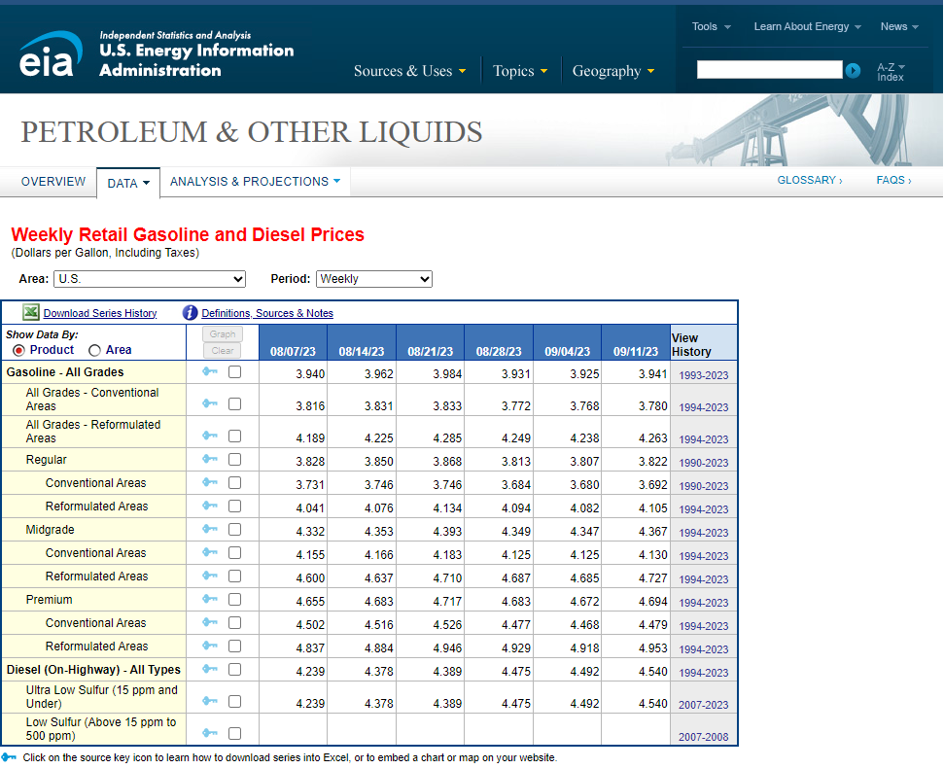
SOP Weekly Project Update – September 15, 2023 – EIA Index Analysis
9/15 Update:
National Average:
Diesel: $4.54/gallon
2W:
Diesel: 1.45% increase
Last 2 weeks: $4.48/gallon
Source: https://www.eia.gov/dnav/pet/pet_pri_gnd_a_epd2d_pte_dpgal_w.htm

Slide 14

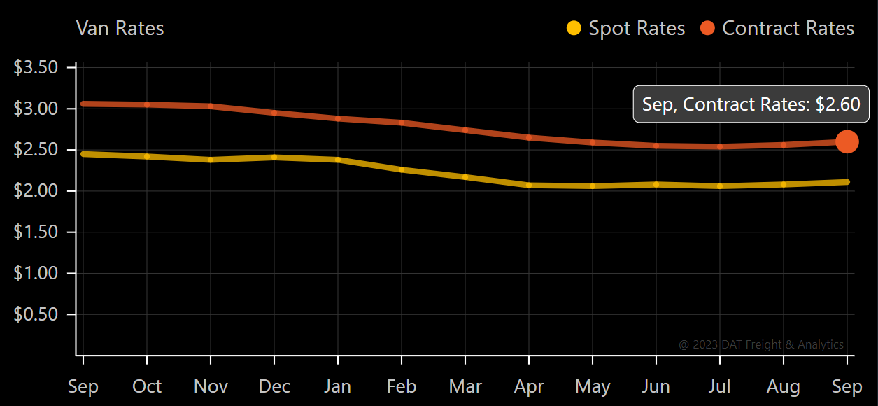
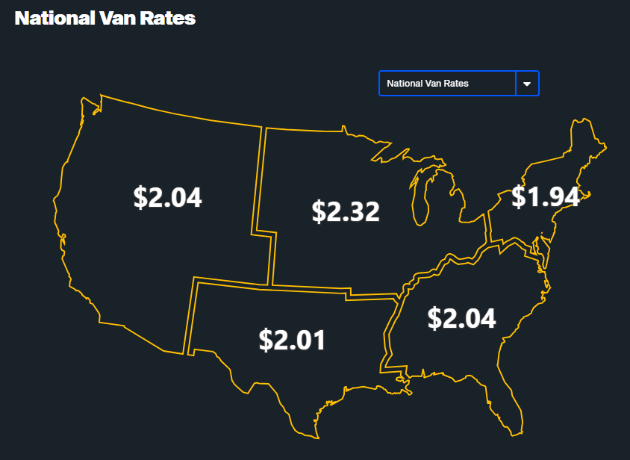
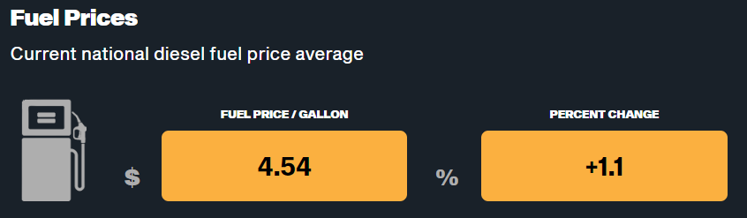
SOP Weekly Project Update – September 15, 2023 – Inland Shipping Cost Index Analysis
9/15 Update:
Contract Rates:
2W - Sep 1st ($2.48/mile) to Sep 15th ($2.60/mile):
4.84% increase
From LA → Houston (1,436 mi.) = $0.0209/w
From NY → Houston (1,546 mi.) = $0.0221/w
YTD – Jan 1st 2023 ($2.90/mile) to
Sep 15th ($2.60/mile):
10.34% decrease
1Y – From Sep 2022 ($3.06/mile) to
Sep 15th ($2.60/mile):
15.03% decrease
Source: https://https://www.dat.com/trendlines/van/national-rates

Slide 15
Exchange Rate
Index Analysis

Slide 16

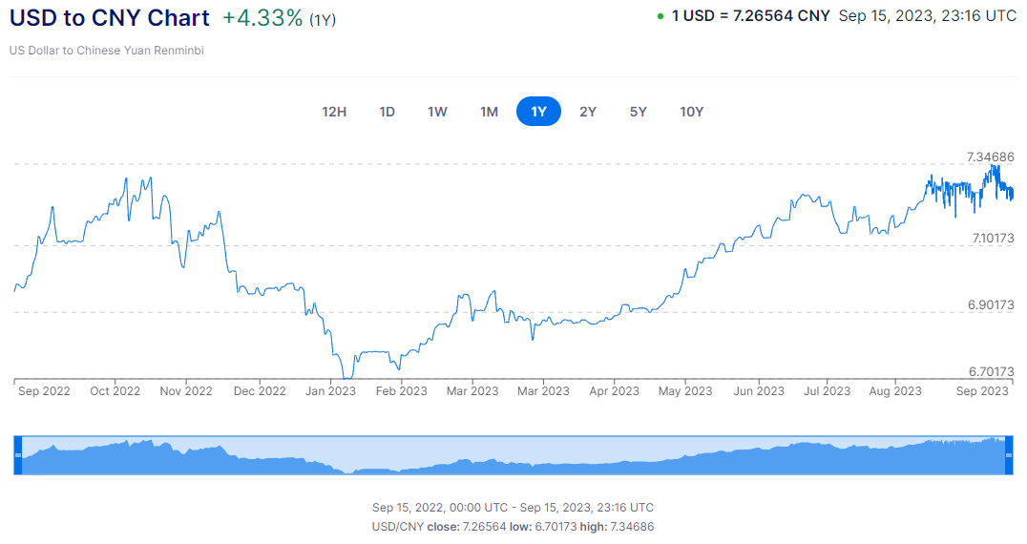
SOP Weekly Project Update – September 15, 2023 – Exchange Rate Index Analysis
9/15 Update: USD to CNY Exchange Rate for 1Y
2W – Sep 1st (7.225RMB) to Sep 15th (7.266RMB)
0.57% increase
Last meeting: 0.08% increase
YTD – Jan 1st 2023 (6.905 RMB) to Sep 15th (7.266RMB)
5.23% increase
1Y – Sep 2022 (6.893 RMB) to Sep 15th (7.266RMB)
5.41% increase
https://www.xe.com/currencycharts/?from=USD&to=CNY

Slide 17
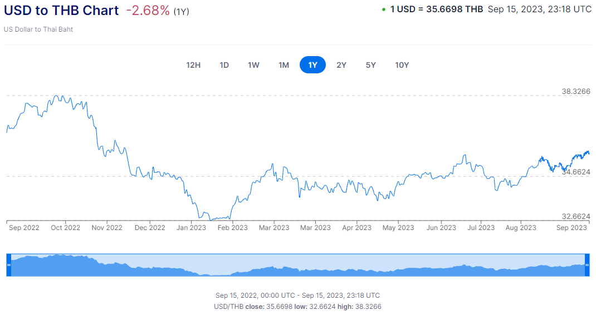
SOP Weekly Project Update – September 15, 2023 – Exchange Rate Index Analysis
9/15 Update: USD to THB Exchange Rate for 1Y
2W – Sep 1st (35.118 THB) to Sep 15th (35.670 THB)
1.57% increase
Last meeting: 0.12% decrease
YTD – Jan 1st 2023 (34.531 THB) to Sep 15th (35.670 THB)
3.30% increase
1Y – Sep 2022 (36.637 THB) to Sep 15th (35.670 THB)
2.64% decrease
https://www.xe.com/currencycharts/?from=USD&to=THB

Slide 18
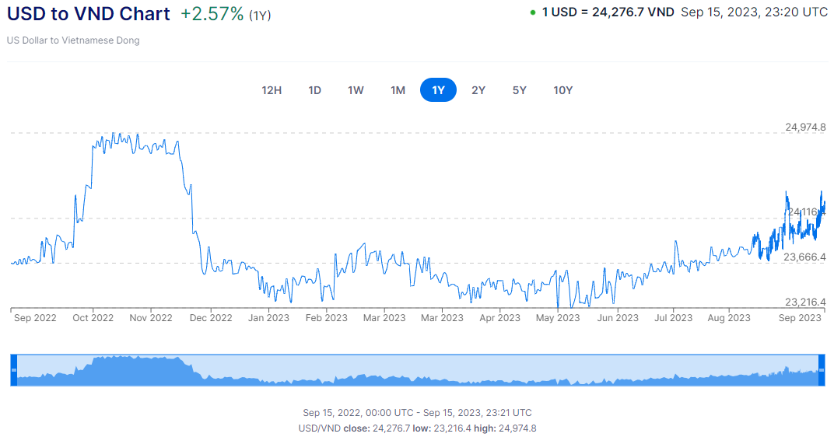
SOP Weekly Project Update – September 15, 2023 – Exchange Rate Index Analysis
9/15 Update: USD to VND Exchange Rate for 1Y
2W – Sep 1st (24,003 VND) to Sep 15th (24,276 VND)
1.14% increase
Last meeting: 0.26% increase
YTD – Jan 1st 2023 (23,629 VND) to Sep 15th (24,276 VND)
2.74% increase
1Y – Sep 2022 (23,464 VND) to Sep 15th (24,276 VND)
3.46% increase
https://www.xe.com/currencycharts/?from=USD&to=VND

Slide 19
Competitor Import Data Analysis

Slide 20
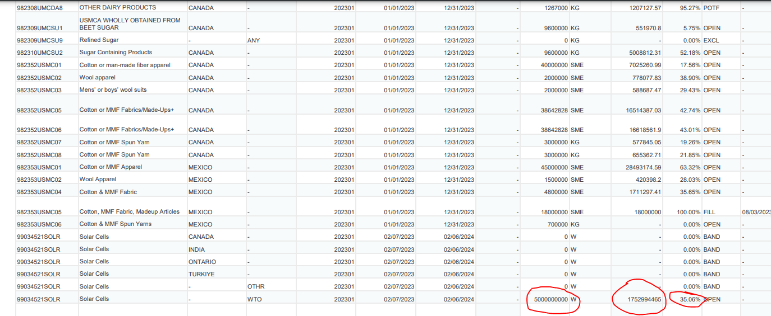
201 Duty Free Solar Cell Quota- CBP

Slide 21
Cell, Frame, Glass, EVA and J-Box

Slide 22
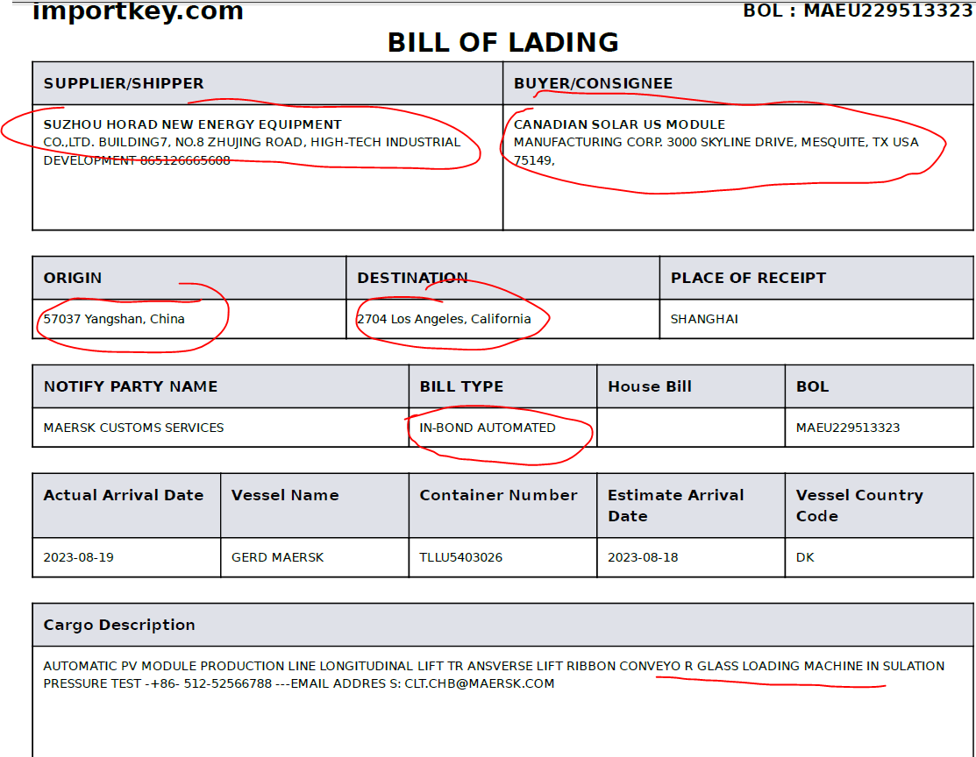
COMPETITORS BOMS
23 out of 101 containers at FTZ/bonded in LB
EL Test
Glass Loading Machine
AUTOMATIC GLUE FILLING MACHINE
LOADING AND UNLOADING TRANSPLANTER TYPE-SETTING MA

Slide 23
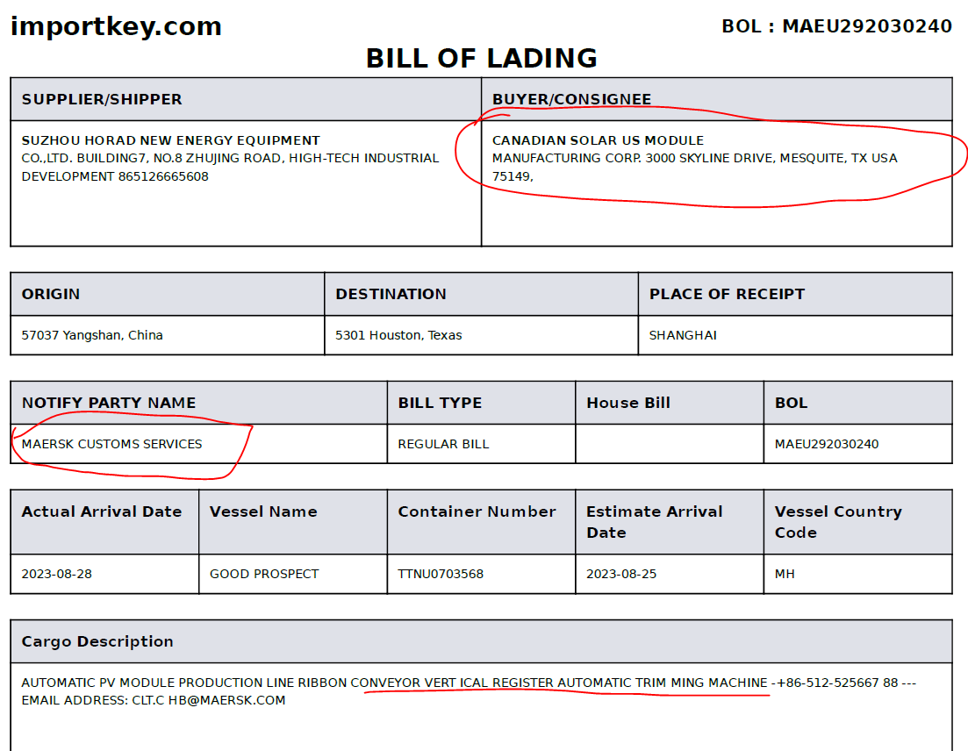
COMPETITORS BOMS
苏州宏达新能源：：RIBBON CONVEYOR VERT ICAL REGISTER AUTOMATIC TRIM MING MACHINE
： RIBBON CONVEYOR SEMI -AUTOMATIC PUNCH PRESS S-MAT ERIAL CUTTING MACHINE
：AUTOMATIC PV MODULE PRODUCTION LINE HORIZONTAL REGISTER
：BORDER GLUING MACHINE AUTO FRAMING RIBBON CONVEY OR REPAIR AND TRANSPLANT
： AUTO FRAMING VERTICA L REGISTER J-BOX COVER INSTA LLATION MACHINE
：SWITCH CUBICLE&SVG(BE USED FOR SOLAR MACHINE)
：MANU AL LONGITUDINAL ROTATION (AUTO MATIC)
：180 DEGREE FLIPPER R IBBON CONVEYOR CSS SPRITE TO OLS
：FINI SHING CORNER MACHINE
：MARK ER CACHE MANUAL LONGITUDINAL ROTATION
宁夏小牛自动化设备股份有限公司 （银川）： AUTO BUSSING MACHINE
无锡奥特维： ：MBB PV CELL SOLDERING STRINGER

Slide 24
THANK YOU

Slide 25
US Federal Funds Rate and Prime Rates
(May 2023)

Slide 26
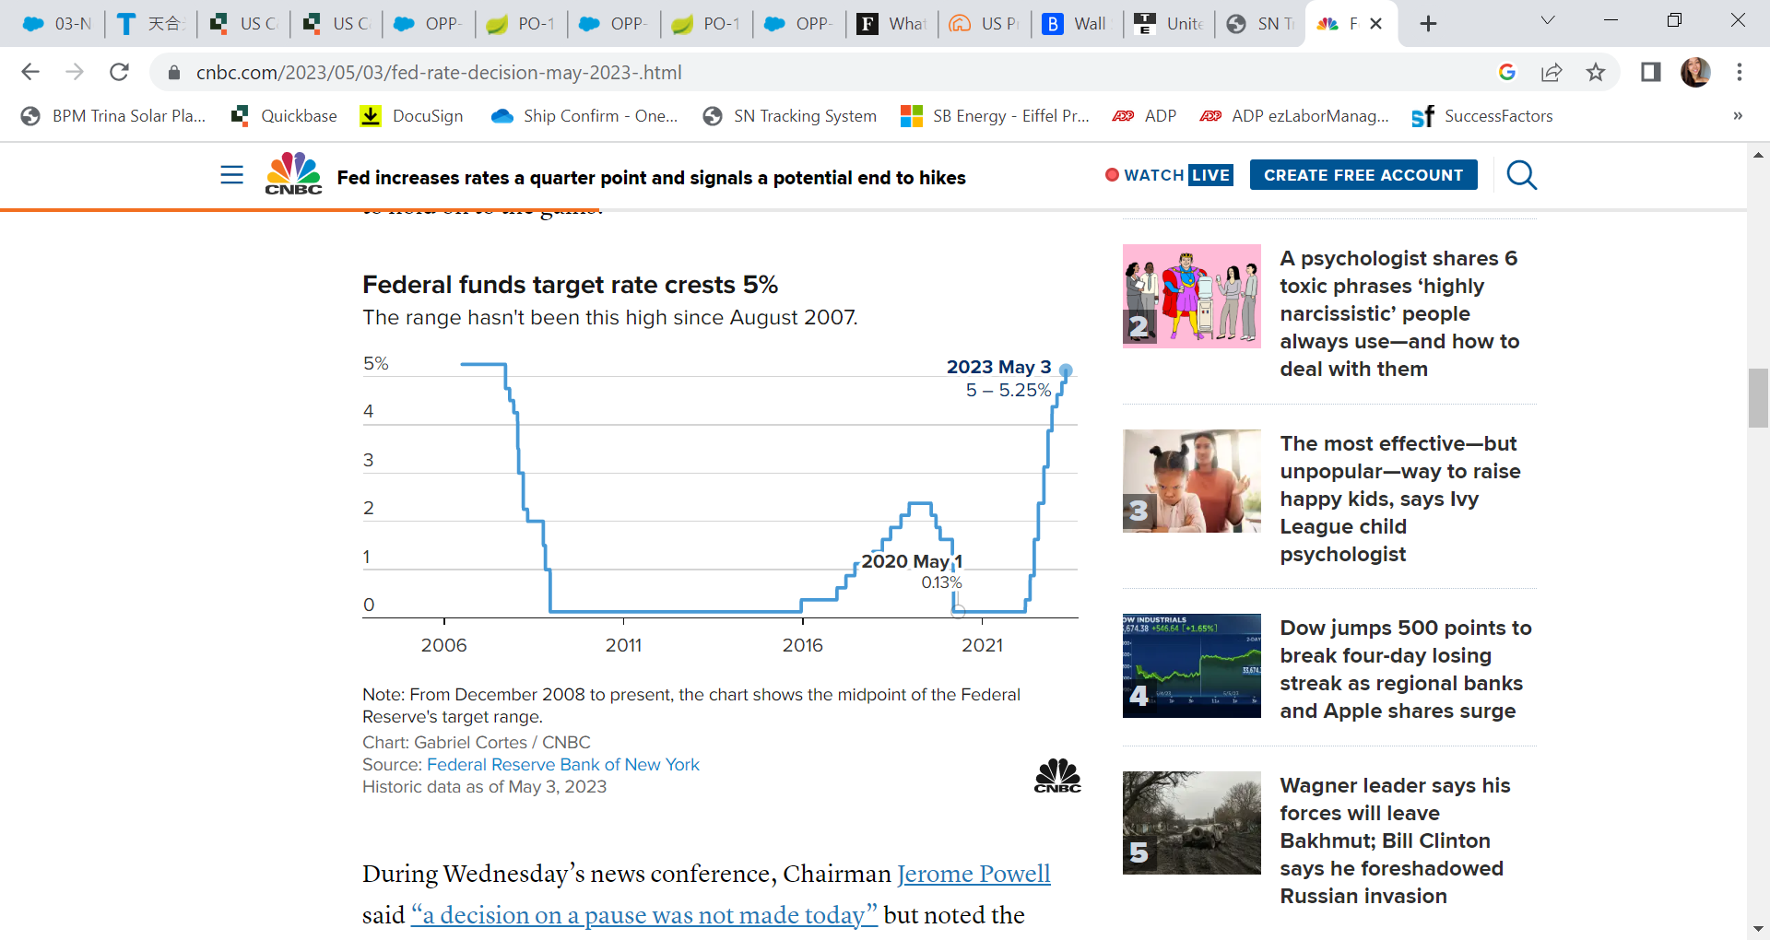
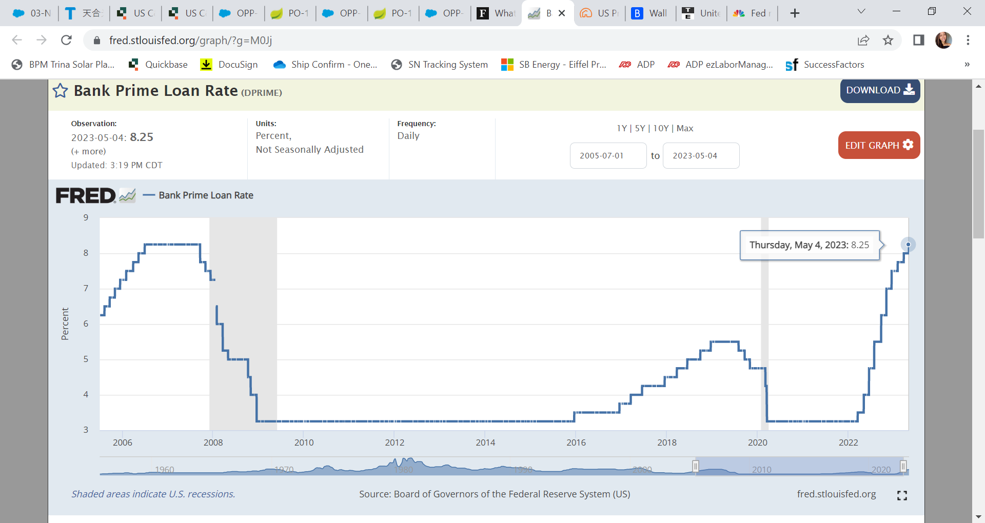
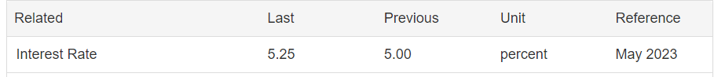
SOP Weekly Project Update – September 15, 2023 – US Federal Funds Rate / Prime Loan Rate
Fed funds rate (May 2023): 5 - 5.25%
Prime Rate (May 2023): 8.25%
Source: https://tradingeconomics.com/united-states/interest-rate
https://fred.stlouisfed.org/graph/?g=M0Jj

Slide 27
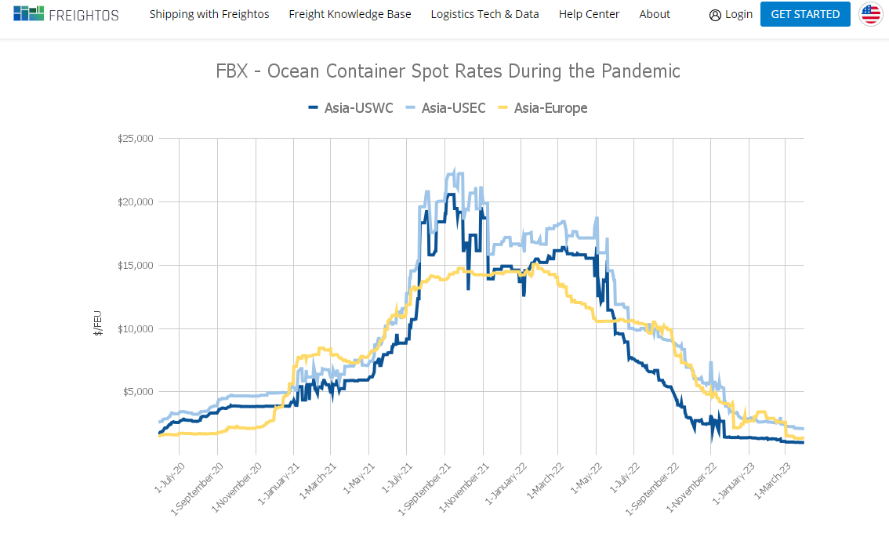
SOP Weekly Project Update – September 15, 2023 – Ocean Shipping Cost Index Analysis
Freight Cost Changes from 2020-2023
Source: https://fbx.freightos.com/freight-index/FBX03

